Slide 1
Lucid Weekly Status Report
31st Mar 2023

Slide 2
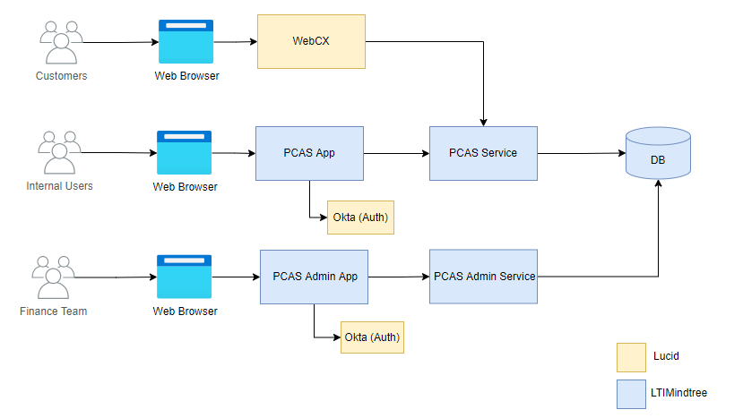
Lucid – PCAS (Payment Calculator As a Service)
The goal of the project is to replace the existing payment calculator with a new service that can obtain accurate and up-to-date information on products, prices, residual values, taxes, and fees from trusted sources.
The new service should enable Lucid's customers to obtain the most accurate possible cost and monthly payment estimates on loan and lease options.
Additionally, the new payment calculator should reduce the workload of Lucid's Financial Services team by eliminating the need for manual updates via admin portal.
Notes:
Source: Investor Presentation 2021, Annual Report 2021

Slide 3
Scope & Timelines
Scope : Application Development (2 microservices & 2 web applications)
Develop payment calculator service for cash, loan & lease options.
Develop Internal Calc UI for Lucid employees to perform payment calculation.
Develop admin app & service for managing datasets like residual values, money factor, APR.
Integration support for WebCX Team(Lucid)
UAT Support & Prod Release
Timelines
S No | Task | Planned Start Date | Planned End Date | Actual Start Date | Actual End Date | Status | Progress
1 | Requirements & Design | 10-Mar-2023 | 14-Mar-2023 | 10-Mar-2023 | 14-Mar-2023 | Completed | 100%
2 | PCAS Service – Dev & Testing | 14-Mar-2023 | 30-Mar-2023 | 14-Mar-2023 | 2-Apr-2023 | Completed | 100%
3 | PCAS App – Dev & Testing | 14-Mar-2023 | 30-Mar-2023 | 14-Mar-2023 | 2-Apr-2023 | Completed | 100%
4 | Admin App – Dev & Testing | 14-Mar-2023 | 06-Apr-2023 | 14-Mar-2023 | TBD | In Progress | 95%
5 | Integration Support | 10-Apr-2023 | 14-Apr-2023 | TBD | TBD | Yet to start | 0%
6 | UAT & Prod Release | 14-Apr-2023 | 21-Apr-2023 | TBD | TBD | Yet to start | 0%
Notes:
Source: Investor Presentation 2021, Annual Report 2021

Slide 4
Accomplishments & Key Callouts for Current Week
Accomplishments
Key Callouts
PCAS app – Completed
PCAS service – Completed
PCAS admin portal - Completed
Apps and services are deployed to DEV environment.
Admin portal demo
Notes:
Source: Investor Presentation 2021, Annual Report 2021

Slide 5
Activities Planned Next Week / Next Steps
Activities Planned Next Week (7th Apr to 13th Apr)
Next Steps
CI/CD pipeline setup, Stage deployment
Integrations
Integrations
Security & Architecture review
Notes:
Source: Investor Presentation 2021, Annual Report 2021

Slide 6
Risks/Issues
CI/CD pipeline & Infra for stage/prod is not ready

